Slide 1
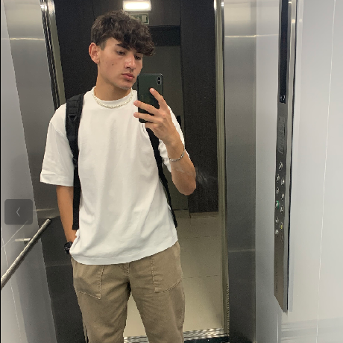
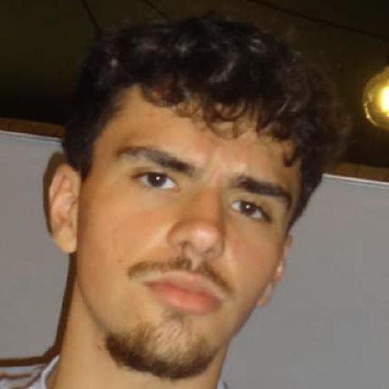
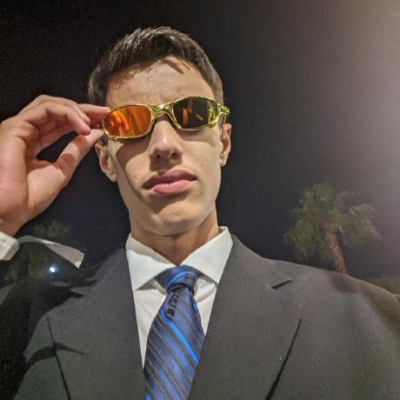
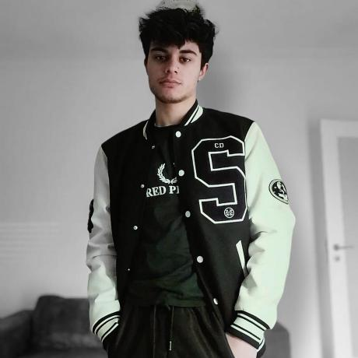
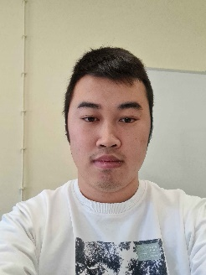
Class 2DM Group 131 SPRINT 2
LAPR3 2024_2025
Group members:
Jorge Ferreira (1231274) | Francisco Santos (1230564) | Emanuel Almeida (1230839) | Paulo Mendes (1231498) | Romeu Xu (1230444)
Foto 1 | Foto 2

Slide 2
Sprint planning – Sprint 2
Planned Start Date: 28 October Real Start Date: 4 of November
Planned Finished Date: 24 of November Real Finish Date: 24 of November
SPRINT BACKLOG
Number of stories: 33
Number of bugs: 0
Number of tasks: 62
Number of Management Tasks (Scrum): 28
Number of team members: 5 | Planned: 5 Actual: 5
Total planned estimation vs execution: | Planned hours: 377h Executed hours: 388h

Slide 3
Sprint planning
Assignment US (as stated on project assignment) | Commited? (Yes / no according to team planning) | Todo | Doing | Testing | Done | Blocked
USAC01 | yes |  |  |  | x
USAC02 | yes |  |  |  | x
USAC03 | yes |  |  |  | x
USAC04 | yes |  |  |  | x
USAC05 | yes |  |  |  | x
USAC06 | yes |  |  |  | x
USAC07 | yes |  |  |  | x
USAC08 | yes |  |  |  | x
USAC09 | yes |  |  |  | x
USAC10 | yes |  |  |  | x
Notes:
Não colocar screenshots! Preencher manualmente os valores.

Slide 4
Sprint planning
Assignment US (as stated on project assignment) | Commited? (Yes / no according to team planning) | Todo | Doing | Testing | Done | Blocked
USBD10 | yes |  |  |  | x
USBD11 | yes |  |  |  | x
USBD12 | yes |  |  |  | x
USBD13 | yes |  |  |  | x
USBD14 | yes |  |  |  | x
USBD15 | yes |  |  |  | x
USBD16 | yes |  |  |  | x
USBD17 | yes |  |  |  | x
USBD18 | yes |  |  |  | x
USBD19 | yes |  |  |  | x
Notes:
Não colocar screenshots! Preencher manualmente os valores.

Slide 5
Sprint planning
Assignment US (as stated on project assignment) | Commited? (Yes / no according to team planning) | Todo | Doing | Testing | Done | Blocked
USEI08 | yes |  |  |  | x
USEI09 | yes |  |  |  | x
USEI10 | yes |  |  |  | x
USEI11 | yes |  |  |  | x
USEI12 | yes |  |  |  | x
USEI13 | yes |  |  |  | x
USEI14 | yes |  |  |  | x
USEI15 | yes |  |  |  | x
USFA01 | yes |  |  |  | x
USFA02 | yes |  |  |  | x
Notes:
Não colocar screenshots! Preencher manualmente os valores.

Slide 6
Sprint planning
Assignment US (as stated on project assignment) | Commited? (Yes / no according to team planning) | Todo | Doing | Testing | Done | Blocked
USLP03 | yes |  |  |  | x
USLP04 | yes |  |  |  | x
USLP05 | yes |  |  |  | x
Notes:
Não colocar screenshots! Preencher manualmente os valores.

Slide 7
Work by team member
Notes:
Se compilaram o registo de horas colocar as horas de trabalho, caso contrario utilizar o numero de tarefas ou algo que reflita a distribuição de trabalho.

Slide 8
Work by type

Slide 9
Issues / Assumptions / unanswered questions
Description | Responsible | Date / sprint | Related issue / item in Git
Late publication of the project assignment. |  | Sprint 2
There was a disconnection between lecturers about the project. |  | Sprint 2

Slide 10
Daily Meetings
Date | Place / duration | Team member 1 | Team member 2 | Team member 3 | Team member 4 | Team member 5
28/10/2024 | Class / 15 min | x | x | x | x | x
29/10/2024 | Class / 15 min | x | x | x | x | x
30/10/2024 | Class / 15 min | x | x | x | x | x
31/10/2024 | Class / 15 min | x | x | x | x | x
01/11/2024 | Class / 15 min | x | x | x | x | x
02/11/2024 | Home / 15 min | x | x | x | x | x
03/11/2024 | Home / 15 min | x | x | x | x | x
04/11/2024 | Class / 15 min | x | x | x | x | x
05/11/2024 | Class / 15 min | x | x | x | x | x
06/11/2024 | Class / 15 min | x | x | x | x | x
07/11/2024 | Class / 15 min | x | x | x | x | x
Notes:
Podem criar mais páginas se estas não forem suficientes

Slide 11
Daily Meetings
Date | Place / duration | Team member 1 | Team member 2 | Team member 3 | Team member 4 | Team member 5
08/11/2024 | Class / 15 min | x | x | x | x | x
09/11/2024 | Home / 15 min | x | x | x | x | x
10/11/2024 | Home / 15 min | x | x | x | x | x
11/11/2024 | Class / 15 min | x | x | x | x | x
12/11/2024 | Class / 15 min | x | x | x | x | x
13/11/2024 | Class / 15 min | x | x | x | x | x
14/11/2024 | Class / 15 min | x | x | x | x | x
15/11/2024 | Class / 15 min | x | x | x | x | x
16/11/2024 | Home / 15 min | x | x | x | x | x
17/11/2024 | Home / 15 min | x | x | x | x | x
18/11/2024 | Class / 15 min | x | x | x | x | x
Notes:
Podem criar mais páginas se estas não forem suficientes

Slide 12
Daily Meetings
Date | Place / duration | Team member 1 | Team member 2 | Team member 3 | Team member 4 | Team member 5
19/11/2024 | Class / 15 min | x | x | x | x | x
20/11/2024 | Class / 15 min | x | x | x | x | x
21/11/2024 | Class / 15 min | x | x | x | x | x
22/11/2024 | Class / 15 min | x | x | x | x | x
23/11/2024 | Home / 15 min | x | x | x | x | x
24/11/2024 | Home / 15 min | x | x | x | x | x
Notes:
Podem criar mais páginas se estas não forem suficientes

Slide 13
LLM assessment (ChatGPT, Copilot, or other)
Ask LLM to analyze the daily meetings records and summarize an evaluation for each team member and for the overall group performance.
Source file (include file as attachment):
(include the source file for all the prompt as attachment)

Slide 14
LLM performance assessment
Output file:
(include file as attachment)
Output:
Jorge consistently delivered key outputs and showed leadership in planning and execution. Clear task prioritization would enhance efficiency further.
Francisco: A reliable contributor with strong execution, but more collaboration with teammates would add further value.
While persistent and detail-oriented, Romeu would benefit from earlier clarification of complex tasks and more efficient problem solving strategies.
Paulo showed commitment but needs to focus on faster iteration and cross-team input for complex tasks.
Emanuel displayed solid technical contributions but would benefit from earlier collaboration for quality assurance.

Slide 15
LLM performance assessment
Comment from the team on the LLM assessment:
While it did the job to showcase somewhat of that the team was doing, it does not translate well for what actually the team members did, since that comes from the perception of the people that worked together, over all it did summarize the things that were written in the daily meetings, but the work is not defined by those.
Suggestion of improvement from LLM:
Not much can be said, with the prompt that was given, it did the job really well by summarizing what was written in the daily meetings.
Notes:
No comentário de cada team member, indicar uma percentagem de acerto do LLM de 0-100%

Slide 16


Overall Project performance:
- LLM evaluation:
Overall the team performed as expected, all the issues were quickly resolved and everyone contributed for the completion of the project.
Team evaluation: 4
Team feeling:

Slide 17
Sprint Retrospective
Date: 24/11/2024
What went well?
Teamwork was very good, every time someone needed help it would have the attention of the team, and it would do anything it could to help.
What went wrong?
Time management, the team did try to manage the time the best it could, but the late introduction of the project assignment did create some management problems.
What we’ve learned?
The team learned that teamwork was crucial for the completion of the sprint, everything that did get in the way was solved as a team.

Slide 18
Sprint Retrospective
Date: 24/11/2024
Action items:
Manage better the time.
Ensure that the daily meetings are even more efficient.
Maybe hold a mid-sprint check to review the progress.

Slide 19


